Slide 1
Accommodation Contract Lifecycle Management
(Rentrack)
Javeria Khalid (SE-065)
Areeba Kamal (SE-054)
Yamna Wasi (SE-011, Batch 2014-15)

Slide 2
Overview
Gives users the facility to go through real estate processes online, such as
to lease an apartment
fill/sign contracts
extend contracts etc,
instead of physically visiting a real estate office to get the job done.
After choosing the desirable apartment/house, the user
fills and signs a contract form
Submits it to the website
Approved by the landlord
Apartment/house is leased to the user
The aim of this project is to automate the intermediary processes when leasing apartments or properties to make the process much easier and quicker for the customers.

Slide 3
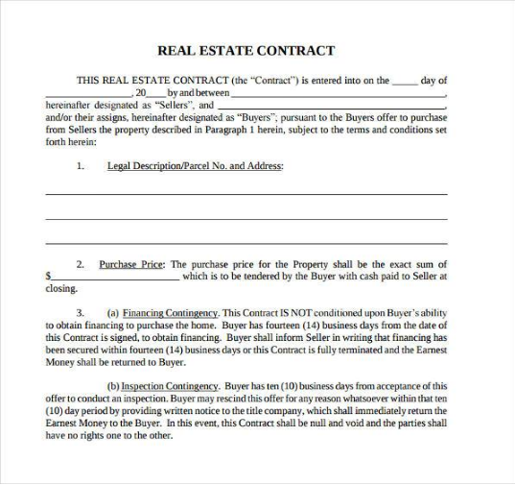
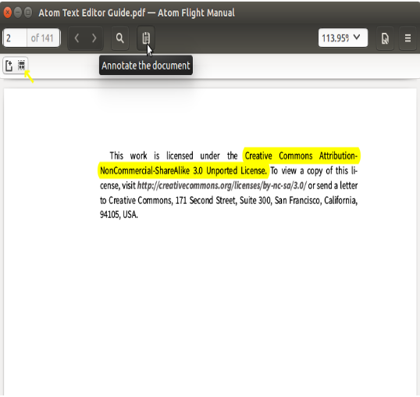
Features
Contract Templates
Generate Contracts using templates
Avoid ambiguity and disagreements through smooth dealings
Highlighting
Highlight specific parts of the contract you disagree with and recommend changes

Slide 4
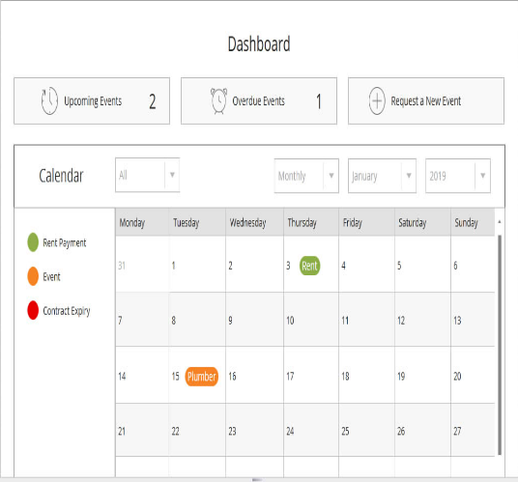
Features
Dashboard
Keep track of
Rent payment dates
Inspections
Contract renewals
Maintenance
View upcoming events in
Yearly
Monthly
Weekly
calendar

Slide 5


Features
Notifications
Stay alert for the upcoming events by receiving notifications. Accept, Edit or Reject requests from the tenant.
Feedbacks and Ratings
Drop feedbacks and ratings about the landlord, tenant, apartment rented and its timely maintenance.

Slide 6
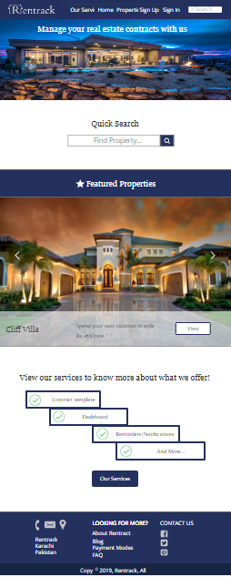
Current Status
Accomplishments
Gathered requirements
Created prototype

Slide 7
Current Status
Problem Areas
Revision of project proposal as advised
Activities of previous project halted
Solution
Changed our schedule to accommodate new tasks and now we are on track

Slide 8
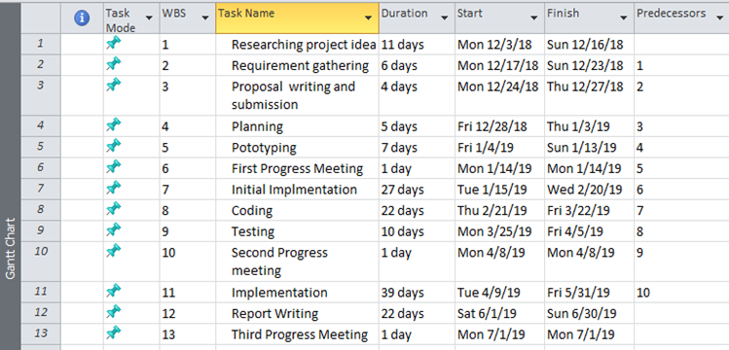
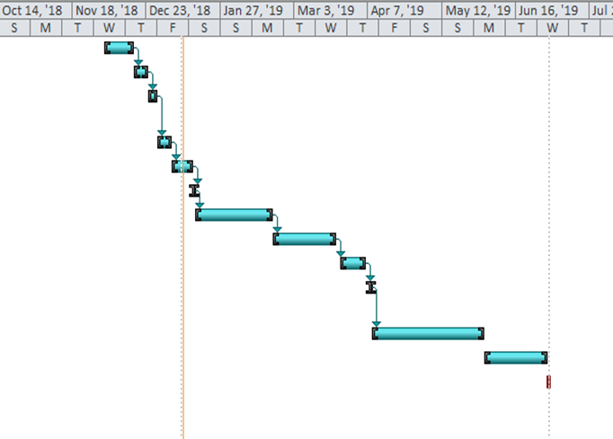
Project Timeline

Slide 9
So far, we have done...
Researching project idea
Requirement Gathering
Proposal
Prototype

